Slide 1
RNN and LSTM
Simply Explained

Slide 2
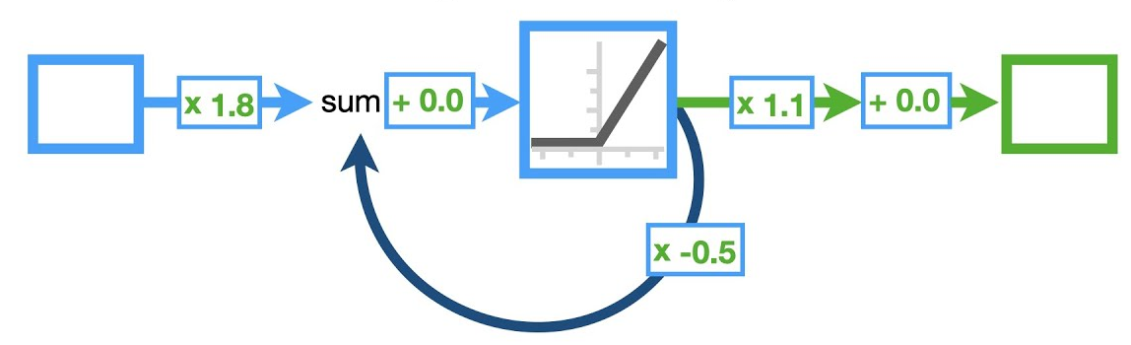
Recurrent Neural Network(RNN)
RNN stands for Recurrent Neural Network. It's a type of artificial neural network designed for sequential data, such as:
Time series
Natural language
Speech
Music

Slide 3
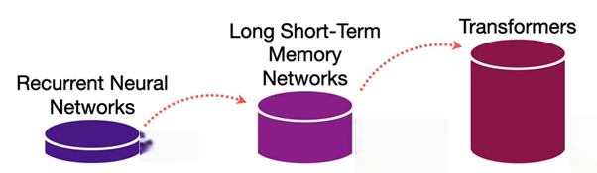
Why RNN ?

Slide 4
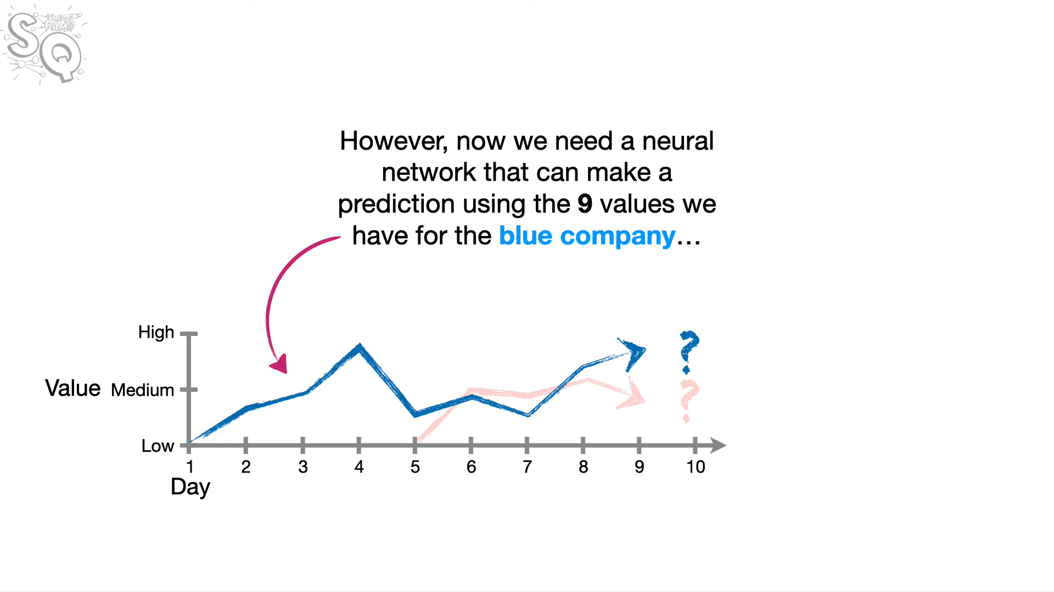
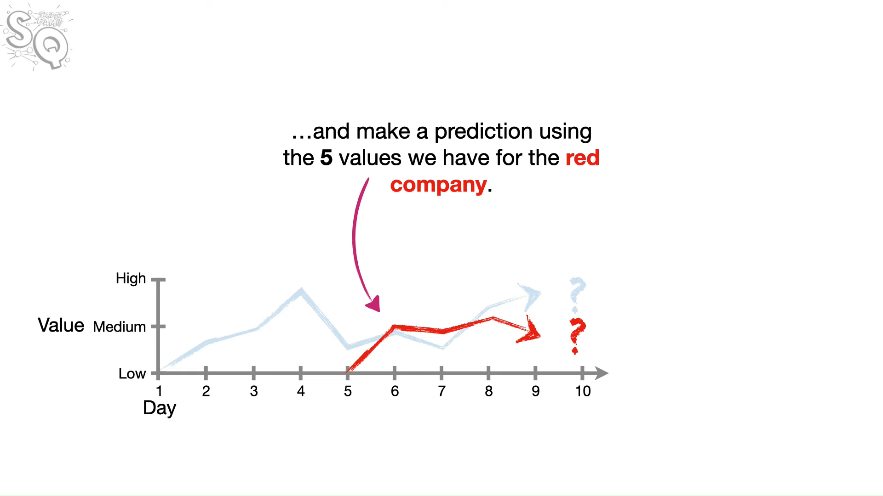
Problem ?

Slide 5
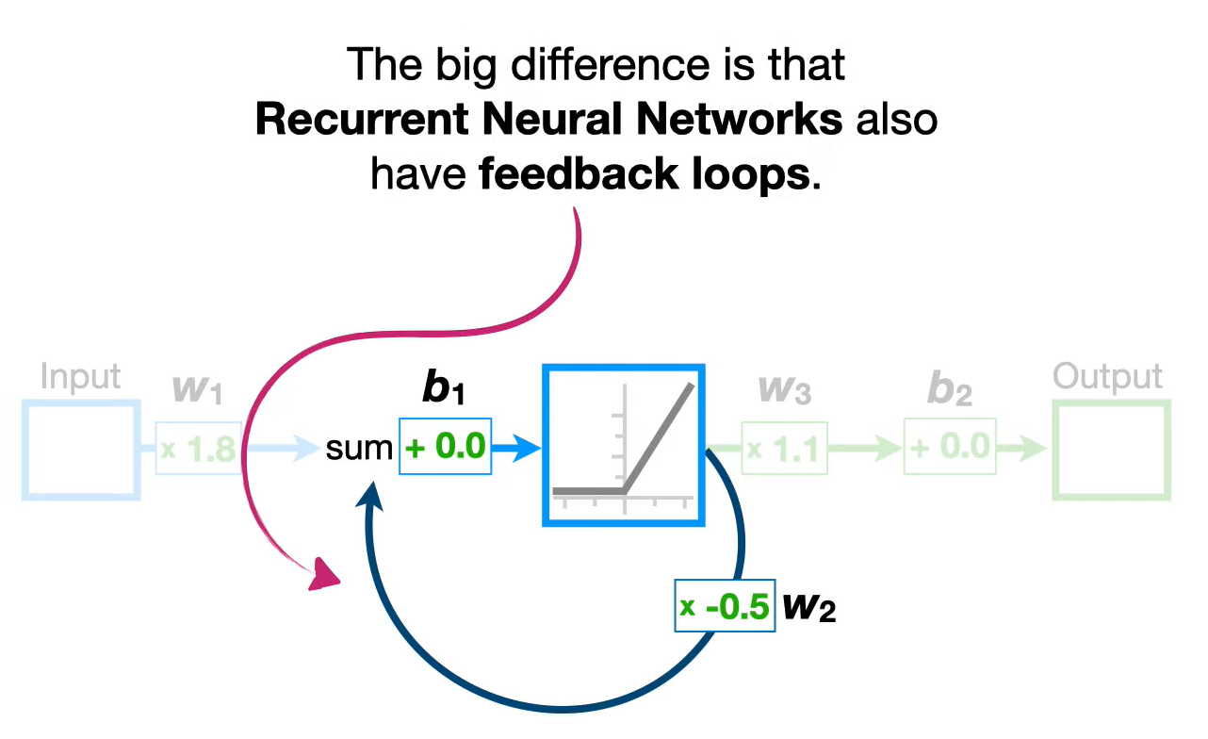
RNN Different from other NN
Unlike traditional neural networks, RNNs have loops in them, allowing information to persist.
They process one element at a time in a sequence, maintaining a memory of previous elements using a hidden state.

Slide 6
Example
Imagine trying to predict the next word in a sentence:
"I love to eat ___"
The RNN remembers the earlier words ("I love to eat") and uses that context to guess the next word ("pizza", "sushi", etc.).

Slide 7
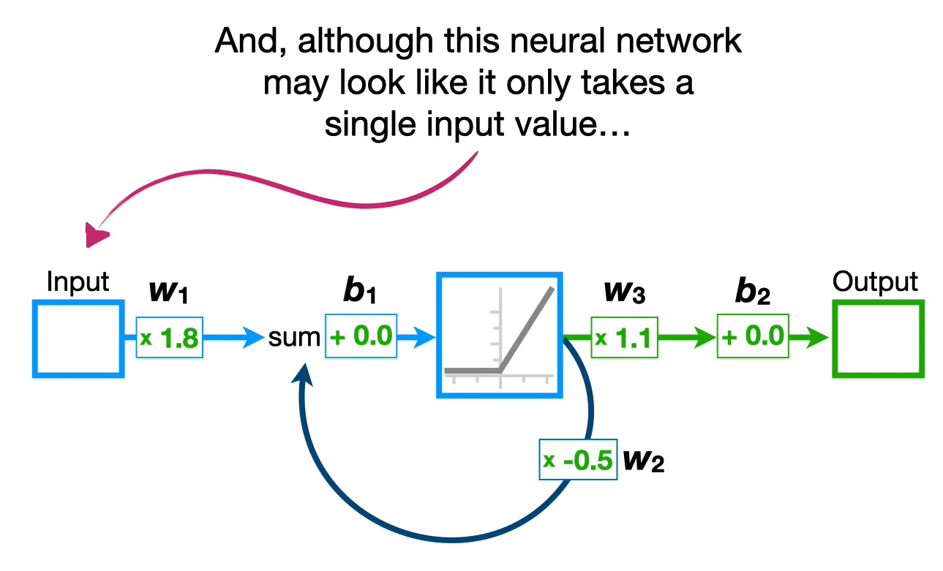
Single Input ?

Slide 8
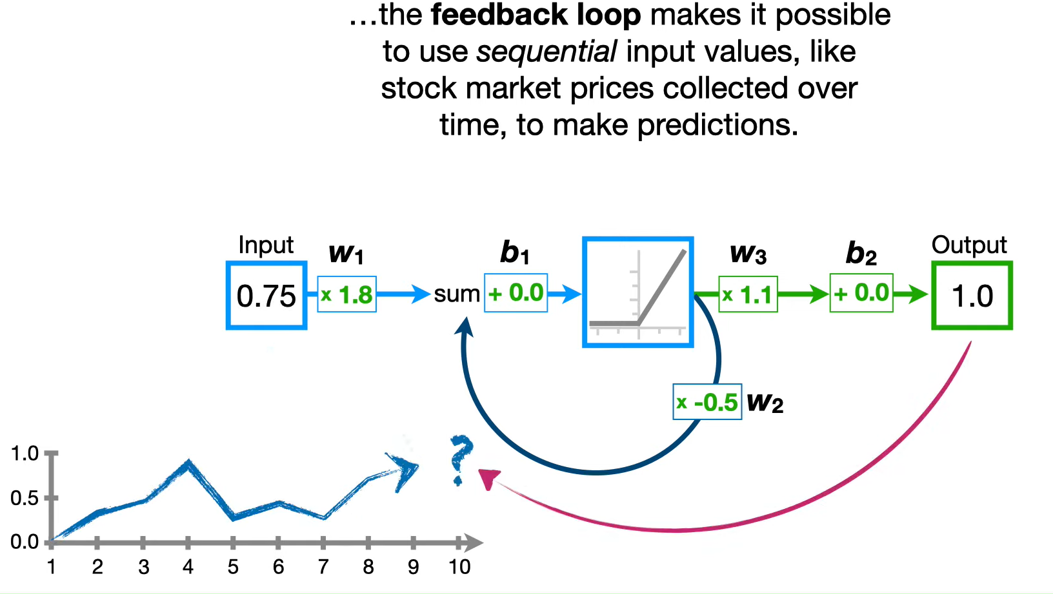
Feed Back Loop

Slide 9
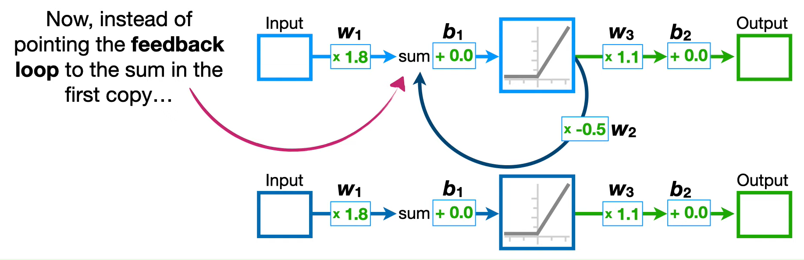
Unroll Feedback Loop

Slide 10
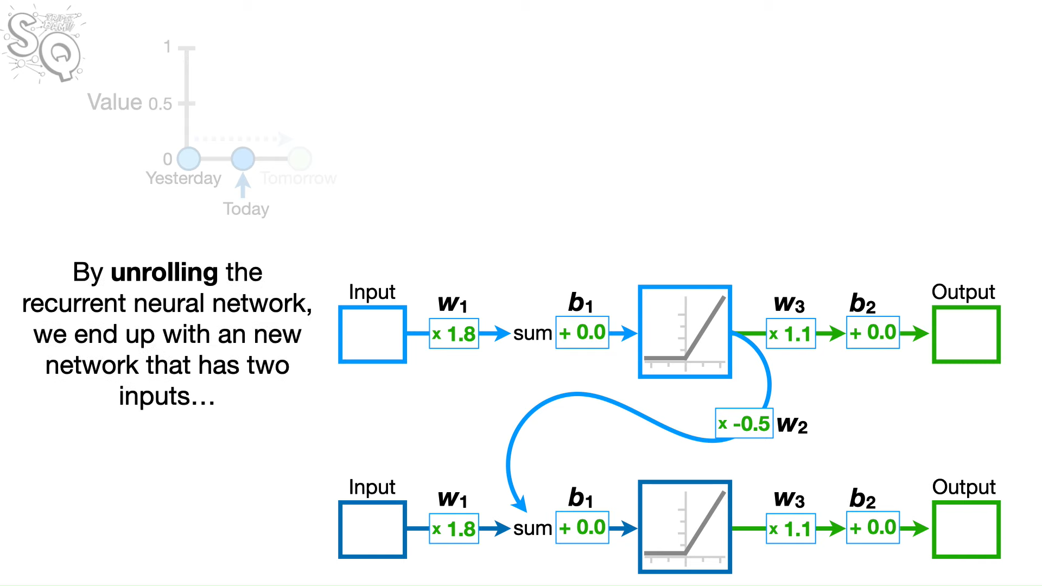
Why Unrolling

Slide 11
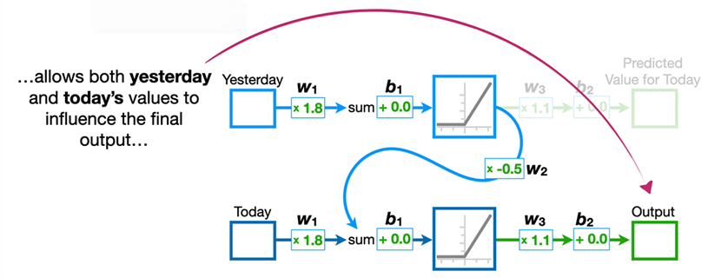
Why Unrolling ?

Slide 12
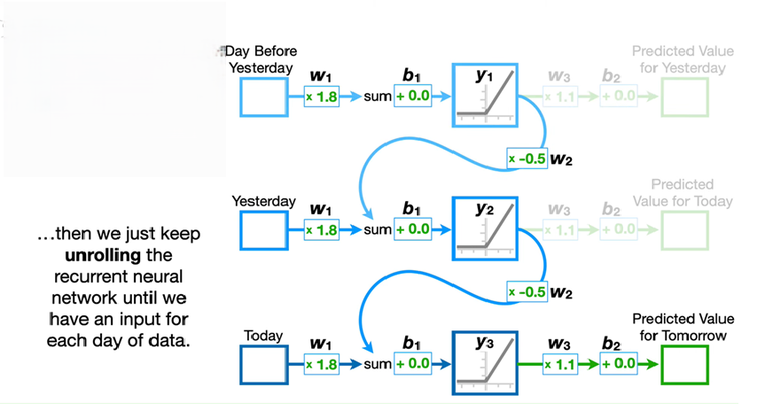
More Inputs ?

Slide 13
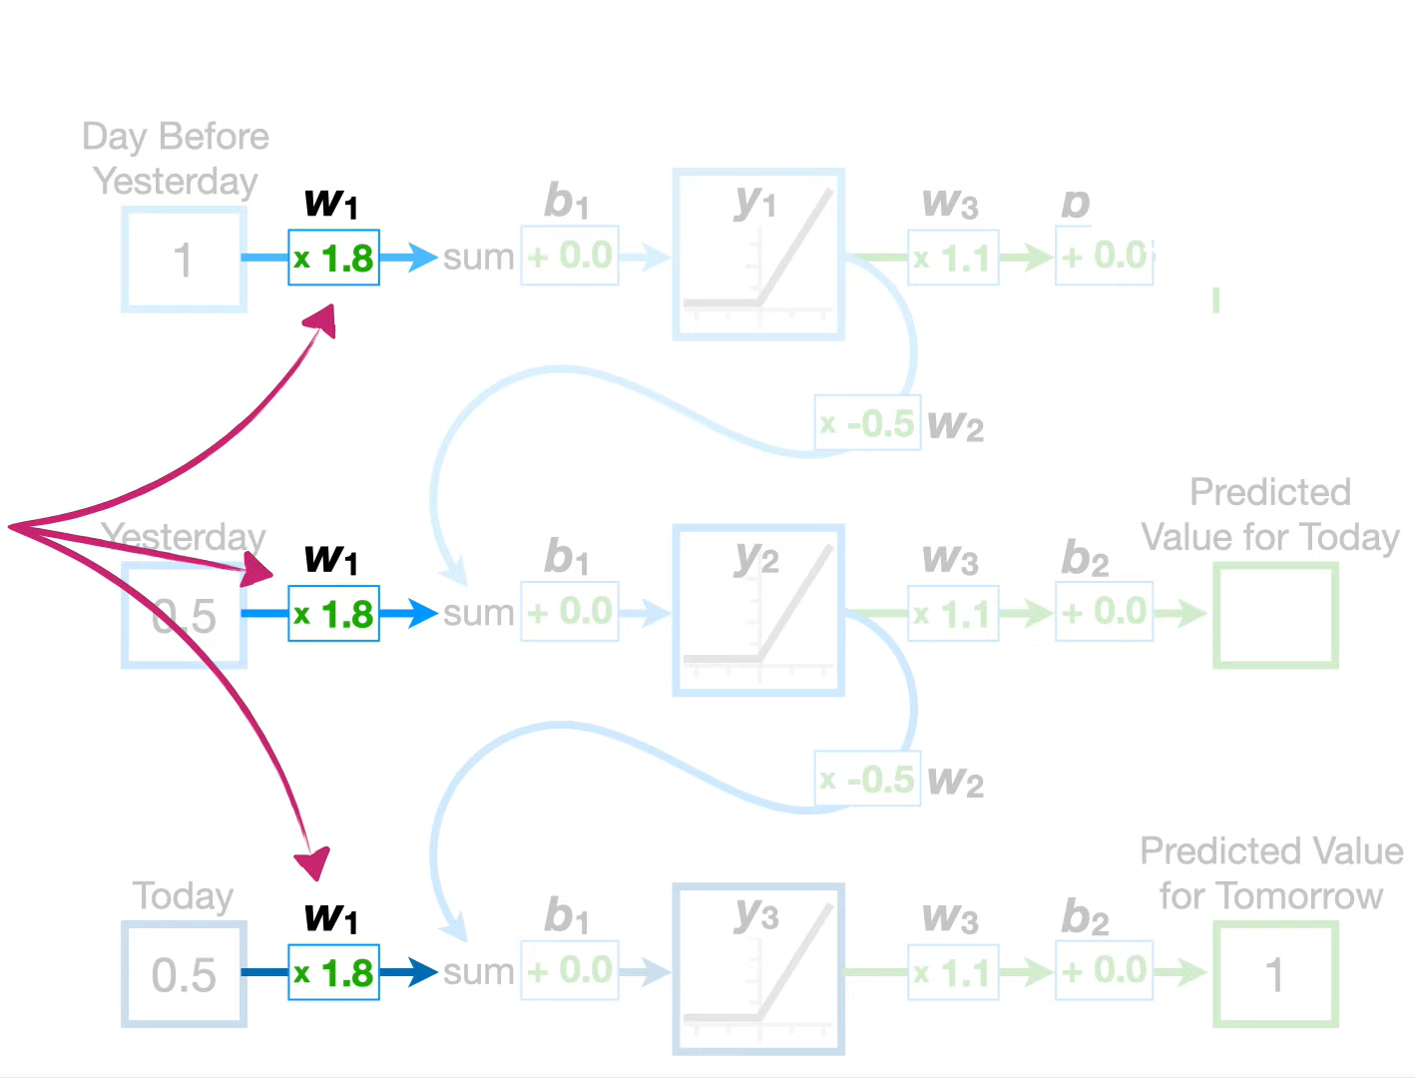
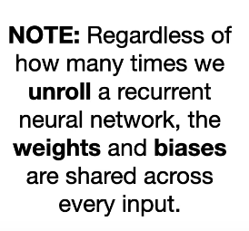
Shared Weights and Biases

Slide 14
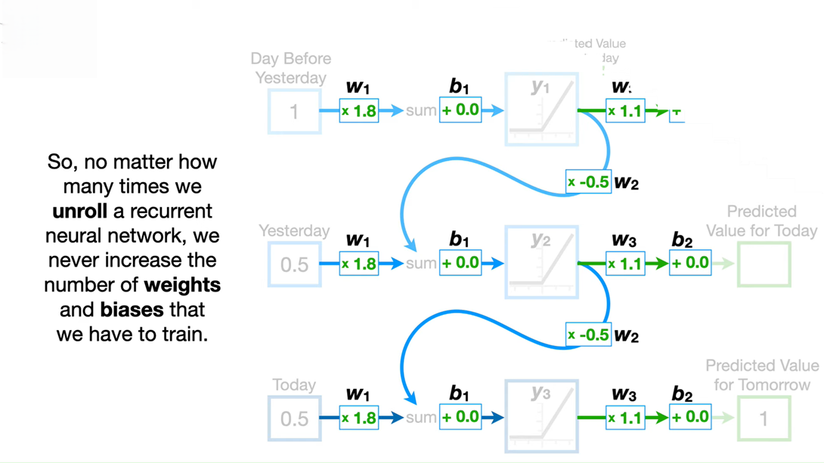
Shared weights and biases

Slide 15
Shared Weights and Biases

Slide 16
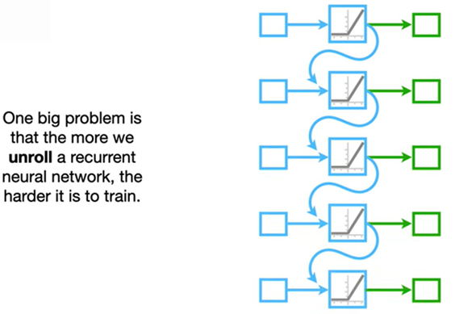
Problems with RNN

Slide 17
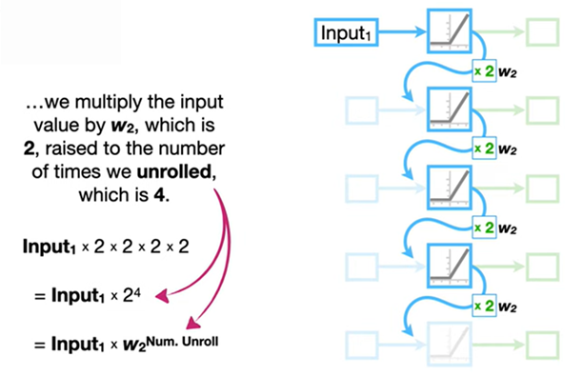
Exploding Gradients
Opposite of vanishing gradients—gradients grow exponentially, causing unstable updates.
These problems make it hard for basic RNNs to learn long-term dependencies.

Slide 18
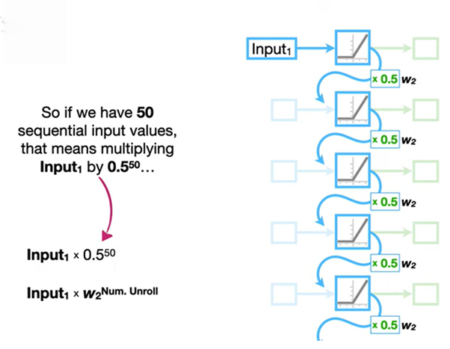
Vanishing Gradients
As sequences get longer, gradients shrink during backpropagation, making it hard to update earlier weights effectively.

Slide 19
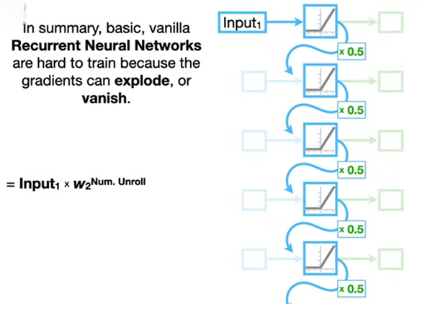
Solution ??→ LSTM
In RNNs, as you backpropagate over many time steps, the gradients can vanish (become too small) or explode (become too large).
This makes learning long-term patterns very difficult.

Slide 20
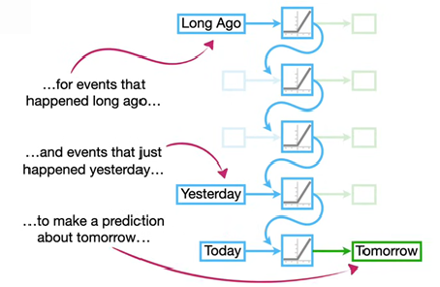
LSTM Basic Idea
LSTM (Long Short-Term Memory) is a special kind of Recurrent Neural Network (RNN) designed to learn long-term dependencies.
It solves the vanishing gradient problem that makes basic RNNs struggle with long sequences.

Slide 21
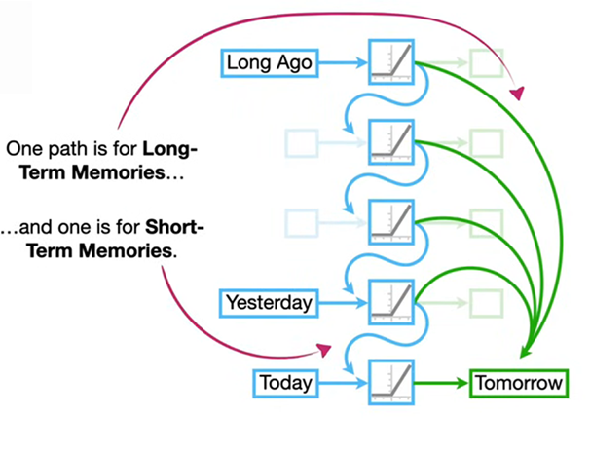
Basic Idea
LSTM networks can remember information for long periods because of their unique architecture, which includes memory cells and gates.

Slide 22
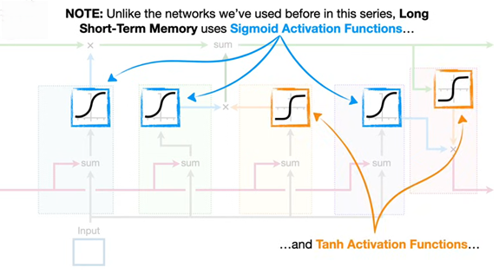
Basic idea LSTM
LSTM networks can remember information for long periods because of their unique architecture, which includes memory cells and gates.
Instead of multiplying the same thing over and over (like RNNs), LSTMs add controlled changes to memory. This makes gradients flow better and lets the network remember important stuff over time.

Slide 23
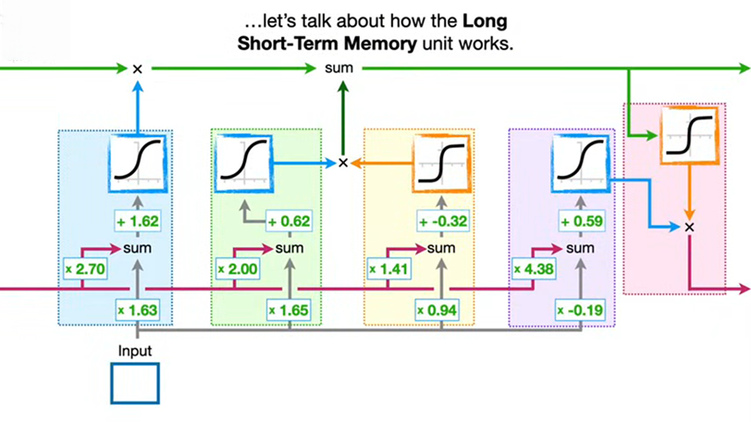
LSTM Units
Each LSTM cell has:
Cell state
Hidden state
Three gates:
Forget Gate: Decides what information to discard from the cell state.
Input Gate: Decides what new information to add to the cell state.
Output Gate: Combine the forget and input gates to update the cell state.

